Slide 1
Chapter 3: Displaying and Describing Quantitative Data
1

Slide 2
3.1 Visualizing Quantitative Variables
The monthly average stock price for six years leading up to a company’s (AIG) financial crisis are shown.
It is hard to tell very much from this table of values.
Just as with categorical data, we wish to display this quantitative data in a picture to clarify what we see.

Slide 3
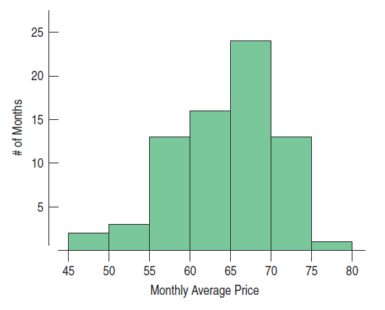
3.1 Visualizing Quantitative Variables
Histograms
A histogram is a graph for a quantitative variable. Since there are no categories, we usually slice up all the possible values into bins and then count the number of cases that fall in each bin.

Slide 4
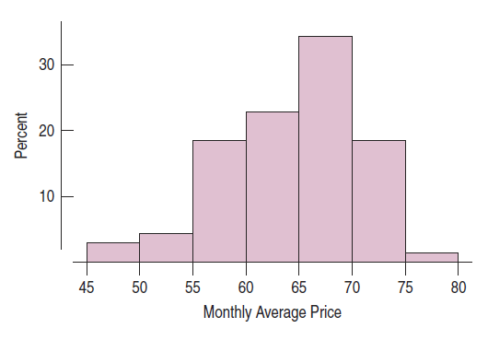
3.1 Visualizing Quantitative Variables
Relative Frequency Histograms
This graph reports the percentage of cases in each bin. The two graphs are the same, except for the labeling of the vertical axis.

Slide 5
3.2 Shape
When describing a distribution, attention should be paid to
its shape,
its center, and
its spread.
We describe the shape of a distribution in terms of its modes, its symmetry, and whether it has any gaps or outlying values.

Slide 6
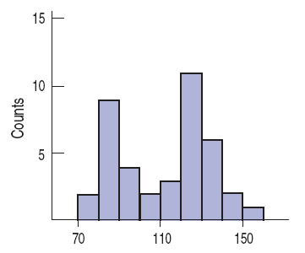
3.2 Shape
Modes
Peaks or humps seen in a histogram are called the modes of a distribution.
A distribution whose histogram has one main peak is called unimodal, two peaks – bimodal (see figure), three or more – multimodal.

Slide 7
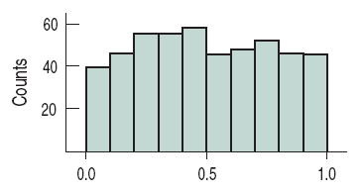
3.2 Shape
Modes
A distribution whose histogram doesn’t appear to have any mode and in which all the bars are approximately the same height is called uniform.

Slide 8
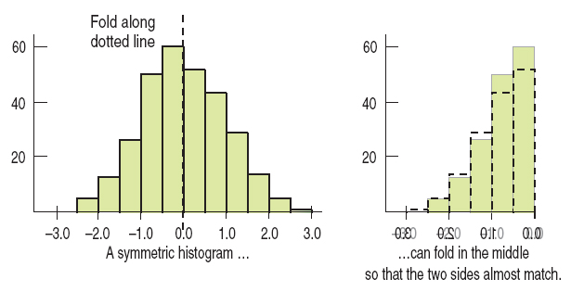
3.2 Shape
Symmetry
A distribution is symmetric if the halves on either side of the center look, at least approximately, like mirror images.

Slide 9
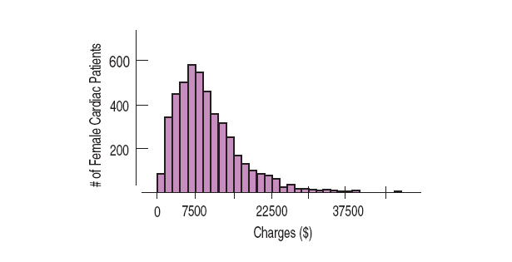
3.2 Shape
Symmetry
The thinner ends of a distribution are called the tails. If one tail stretches out farther than the other, the distribution is said to be skewed to the side of the longer tail. The distribution below is skewed to the right.

Slide 10
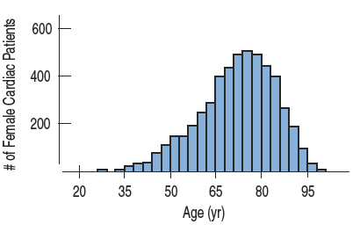
3.2 Shape
Symmetry
The distribution below is skewed to the left.

Slide 11
3.2 Shape
Outliers
Always be careful to point out the outliers in a distribution: those values that stand off away from the body of the distribution. Outliers …
can affect every statistical method we will study.
can be the most informative part of your data.
may be an error in the data.
should be discussed in any conclusions drawn about the data.

Slide 12
3.2 Shape
Characterizing the shape of a distribution is often a judgment call.
Understand the data and how the data was collected.
Think about what kinds of questions you hope to answer using your data values.

Slide 13
3.2 Shape
Example:
How would you describe the shape of the distribution of average stock prices from AIG?

Slide 14
3.3 Center
To find the mean of the variable x add all the values of the variable and divide that sum by the number of data values, n.
We will use the Greek letter sigma to represent sum, so the equation for finding the mean can be written as shown.

Slide 15
3.3 Center
If a distribution is skewed, contains gaps, or contains outliers, then it is better to use the median – the center value that splits the histogram into two equal areas.
The median is found by counting in from the ends of the data until we reach the middle value.
The median is said to be resistant because it isn’t affected by unusual observations or by the shape of the distribution.

Slide 16
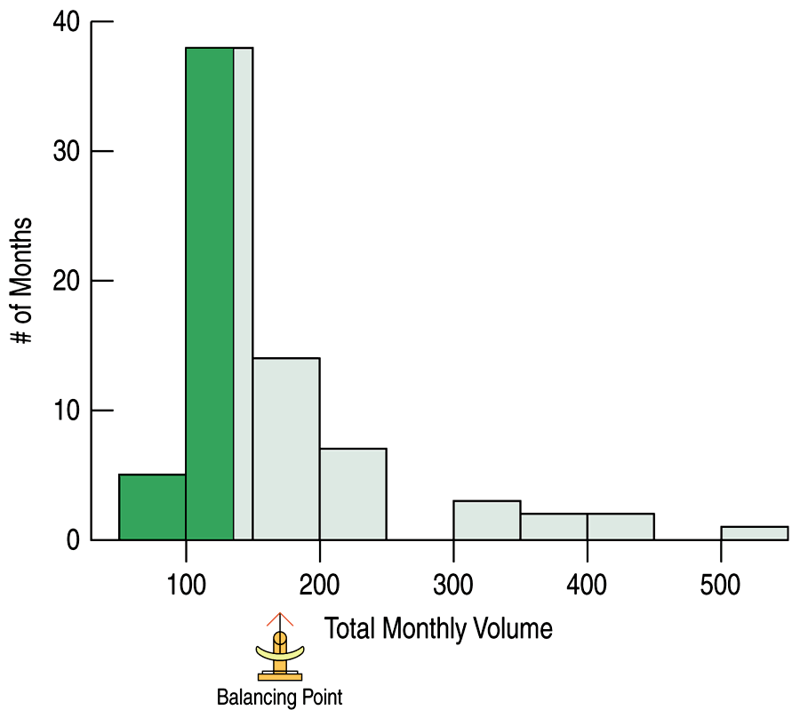
3.3 Center
If a distribution is roughly symmetric, we’d expect the mean and median to be close. The histogram depicts monthly trading volume of AIG shares (in millions of shares) for the period 2002 to 2007. The mean is 170.1 million shares and the median is 135.9 million shares.

Slide 17
3.4 Spread of the Distribution
We need to determine how spread out the data are because the more the data vary, the less a measure of center can tell us.
One simple measure of spread is the range, defined as the difference between the extremes.
Range = max – min

Slide 18
3.4 Spread of the Distribution
The range is a single value and it is not resistant to unusual observations. Concentrating on the middle of the data avoids this problem.
The quartiles are the values that frame the middle 50% of the data. One quarter of the data lies below the lower quartile, Q1, and one quarter lies above the upper quartile, Q3.
The interquartile range (IQR) is defined to be the difference between the two quartile values.
IQR = Q3 – Q1

Slide 19
3.4 Spread of the Distribution
The IQR is a reasonable summary of spread, but because it only uses the two quartiles of data, it ignores much of the information about how individual values vary.
By contrast, the standard deviation takes into account how far each value is from the mean.
Like the mean, the standard deviation is appropriate only for symmetric distributions and can be influenced by outlying observations.

Slide 20
3.4 Spread of the Distribution
As the name implies, the standard deviation uses the deviations of each data value from the mean.
The average of the squared deviations of the values of the variable y from the mean is called the variance and is denoted by s².

Slide 21
3.4 Spread of the Distribution
The variance plays an important role in measuring spread, but the units are the square of the original units of the data.
Taking the square root of the variance corrects this issue and gives us the standard deviation.

Slide 22
3.5 Shape, Center, and Spread—A Summary
Which measures of center and spread should be used for a distribution?
If the shape is skewed, the median and IQR should be reported.
If the shape is unimodal and symmetric, the mean and standard deviation and possibly the median and IQR should be reported.

Slide 23
3.5 Shape, Center, and Spread—A Summary
If there are multiple modes, try to determine if the data can be split into separate groups.
If there are unusual observations point them out and report the mean and standard deviation with and without the values.
Always pair the median with the IQR and the mean with the standard deviation.

Slide 24
3.6 Standardizing Variables
To compare different variables, the values are standardized by measuring how far they are from the mean in terms of the standard deviation.
We measure the distance from the mean and divide by the standard deviation, and the result is the standardized value.
The standardized value tells how many standard deviations each value is above or below the overall mean. Usually we call it a z-score.

Slide 25
3.6 Standardizing Variables
Measure how far a value is from the mean by subtracting the mean and then divide it by the standard deviation. The resulting value is a standardized value or z-score.
For example, a z-score of 2 indicates that a data value is two standard deviations above the mean.

Slide 26
3.6 Standardizing Variables
For Example: Real Estate
Question: A real estate analyst finds from data on 350 recent sales, that the average price was $175,000 with a standard deviation of $55,000. The size of the houses (in square feet) averaged 2100 sq. ft. with a standard deviation of 650 sq. ft.
Which is more unusual, a house in this town that costs $340,000, or a 5000 sq. ft. house?

Slide 27
3.6 Standardizing Variables
Answer: Convert both values to z-scores and compare which is more extreme.
For the $340,000 house:
For the 5000 sq. ft. house:

Slide 28
3.6 Standardizing Variables
For Example: Real Estate
Answer: Because the z-score of 4.46 is a greater number of standard deviations away from its mean, it is the more extreme value.
Therefore, the 5000 square foot house is more unusual.

Slide 29
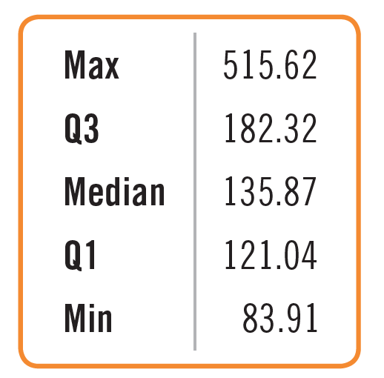
3.7 Five-Number Summary and Boxplots
The five-number summary of a distribution reports its median, quartiles, and extremes (maximum and minimum).
Below is the five-number summary of monthly trading volume of AIG shares (in millions of shares) for the period 2002 to 2007.

Slide 30
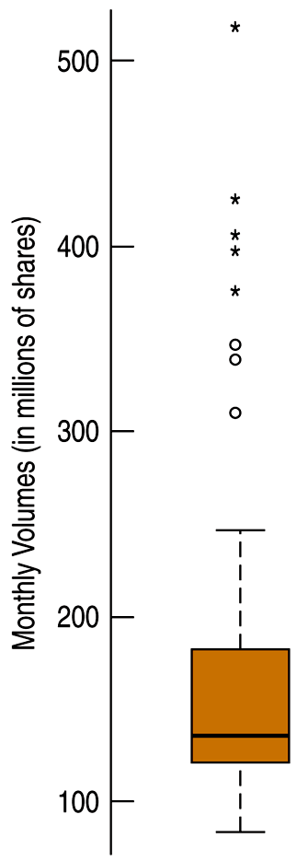
3.7 Five-Number Summary and Boxplots
Once we have a five-number summary of a variable, we can display that information in a boxplot.
A boxplot highlights several features of the distribution of the variable, including the quartiles, the median, and any outlying values.

Slide 31
3.7 Five-Number Summary and Boxplots
The central box shows the middle 50% of the data, between the quartiles – the height of the box equals the IQR.
If the median is roughly centered between the quartiles, then the middle half of the data is roughly symmetric. If it is not centered, the distribution is skewed.
The whiskers show skewness as well if they are not roughly the same length.
The outliers are displayed individually to keep them out of the way in judging skewness and to display them for special attention.

Slide 32
3.7 Five-Number Summary and Boxplots
To make a boxplot:
Locate the median and quartiles on an axis and draw a three short lines. For AIG data, approximate values are Q1= 121, median = 136, and Q3 = 82.
Then connect the quartile lines to form a box.

Slide 33
3.7 Five-Number Summary and Boxplots
3) Determine the “fences” by computing the upper fence 1.5 IQRs above the upper quartile and the lower fence 1.5 IQRs below the lower quartile.
Draw lines (whiskers) from each end of the box up and down to the most extreme data values found within the fences.
5) Display any outliers with special symbols like dots or asterisks.

Slide 34
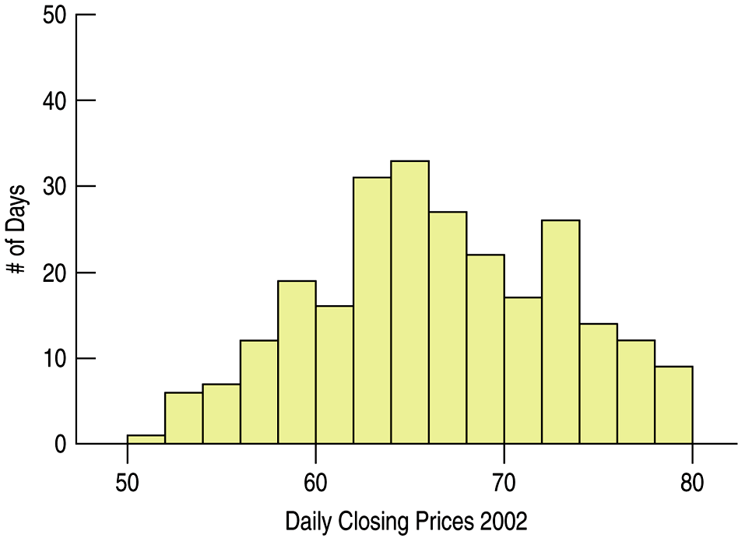
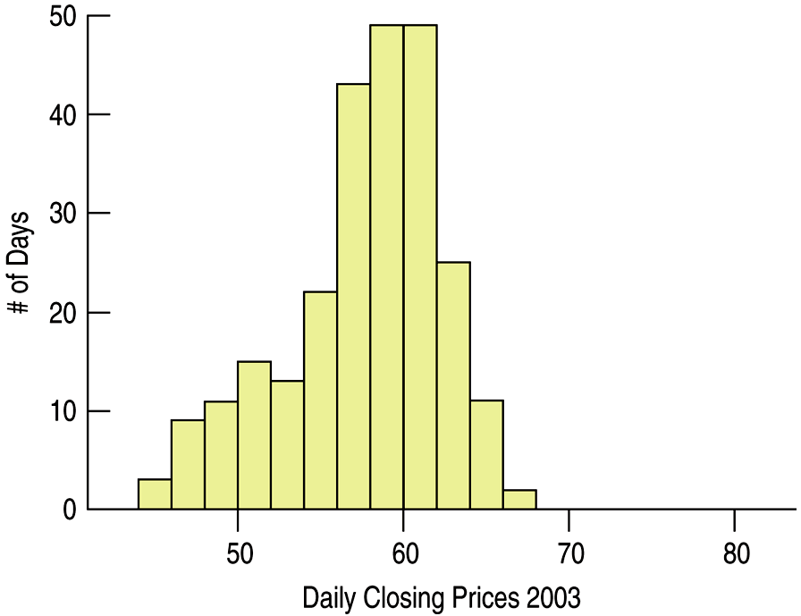
3.8 Comparing Groups
In attempting to understand data, look for patterns, differences, and trends over different time periods.
We can split the data into smaller groups and display histograms for each group. Histograms for AIG data single years (2002 and 2003) are shown below.

Slide 35
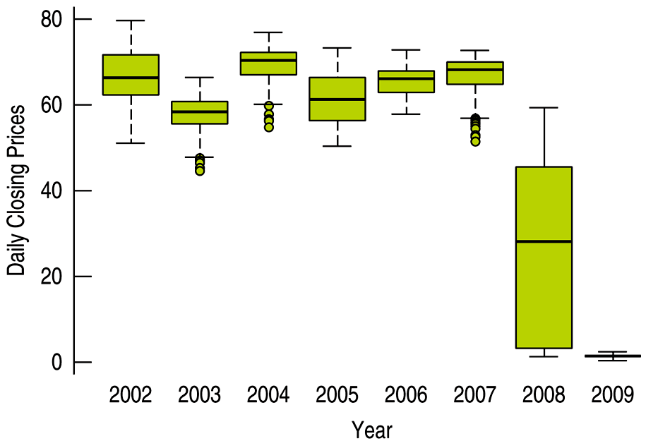
3.8 Comparing Groups
Histograms work well for comparing two groups, but boxplots offer better results for side-by-side comparison of several groups.
Below the AIG data is displayed in yearly boxplots.

Slide 36
3.8 Comparing Groups
Histograms work well for comparing two groups, but boxplots offer better results for side-by-side comparison of several groups.
Below the AIG data is displayed in yearly boxplots.

Slide 37
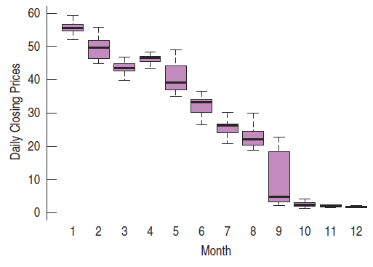
3.8 Comparing Groups
What happened in 2008? We can further partition 2008 into months and compare those boxplots as well:

Slide 38
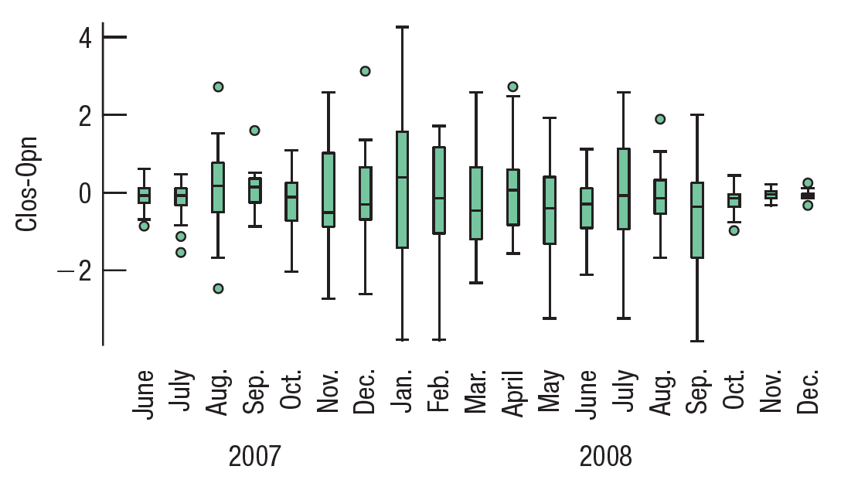
3.8 Comparing Groups
Perhaps we need to consider another measure. So we’ll make boxplots of the daily price spread, Close—Open,
grouped by month for those years.

Slide 39
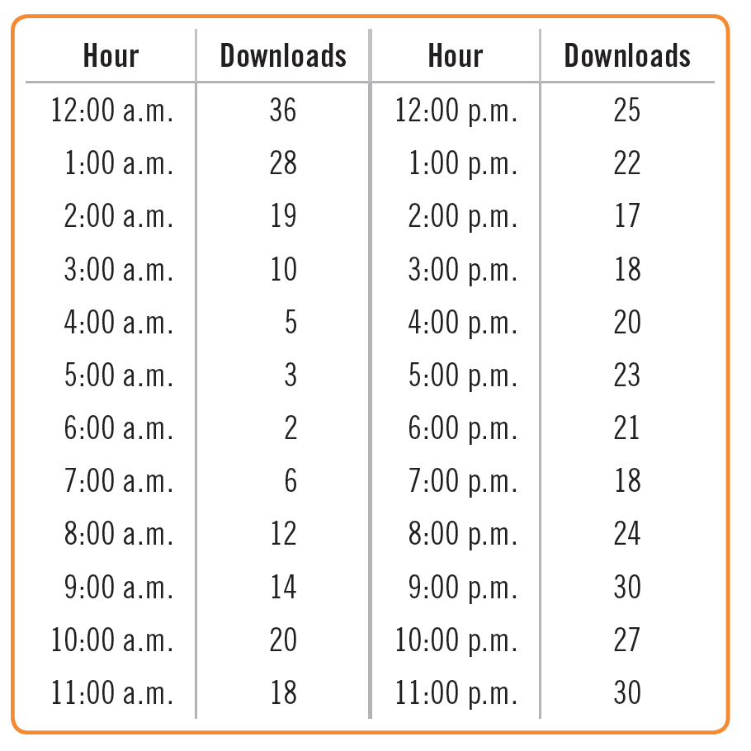
3.8 Comparing Groups
Example: Downloads
The chief financial officer of a music download site just secured the rights to offer downloads of a new music album.
She’d like to see how well it’s selling, so she collected the number of downloads per hour for the past 24 hours.

Slide 40
3.8 Comparing Groups
Example: Downloads
Compare the a.m. downloads to the p.m. downloads by displaying the two distributions side-by-side. Summarize.

Slide 41
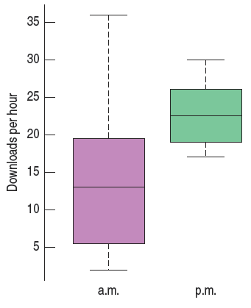
3.8 Comparing Groups
Example: Downloads
There are generally more
downloads in the afternoon than in the
morning.
The median number of afternoon
downloads is around 22 as compared
with 14 for the morning hours.
The p.m. downloads are also much more consistent.
The entire range of the p.m. hours, 15, is about the size of the IQR for a.m. hours.
Both distributions appear to be fairly symmetric, although the a.m. hour distribution has some high points which seem to give some asymmetry.

Slide 42
3.9 Identifying Outliers
What should be done with outliers?
They should be understood in the context of the data. An outlier for a year of data may not be an outlier for the month in which it occurred and vice versa.
They should be investigated to determine if they are in error. The values may have simply been entered incorrectly. If a value can be corrected, it should be.
They should be investigated to determine why they are so different from the rest of the data. For example, were extra sales or fewer sales seen because of a special event like a holiday.

Slide 43
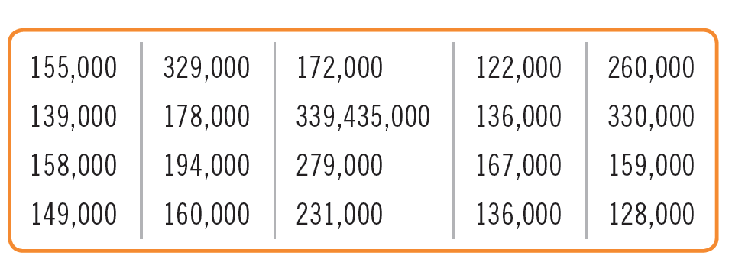
3.9 Identifying Outliers
Example: Real Estate
A real estate report lists the following prices for sales of single family homes in a small town in Virginia (rounded to the nearest thousand).
Write a couple of sentences describing house prices in this town.

Slide 44
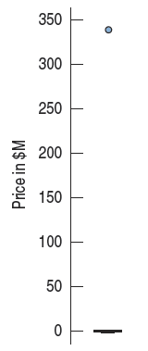
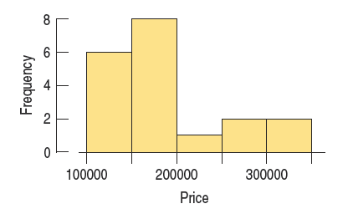
3.9 Identifying Outliers
Example: Real Estate
A boxplot shows an extreme outlier, at $339.4 million. A check on the Internet shows this is clearly a mistake, warranting removal.

Slide 45
3.9 Identifying Outliers
Example: Real Estate
The distribution of prices is strongly skewed to the right. The median price is $160,000.
The minimum is $122,000 and the maximum (without the outlier) is
$330,000.
The middle 50% of house prices lie between $144,000 and $212,500 with an IQR of $68,500.

Slide 46
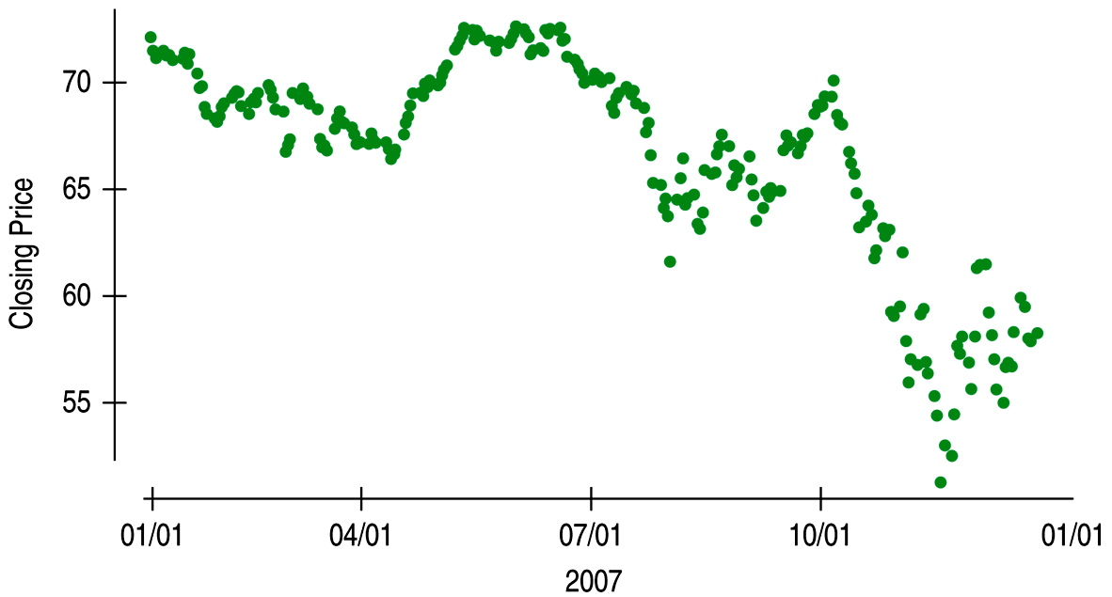
3.10 Time Series Plots
A display of values against time is sometimes called a time series plot. Below we have a time series plot of the AIG daily closing prices in 2007.

Slide 47
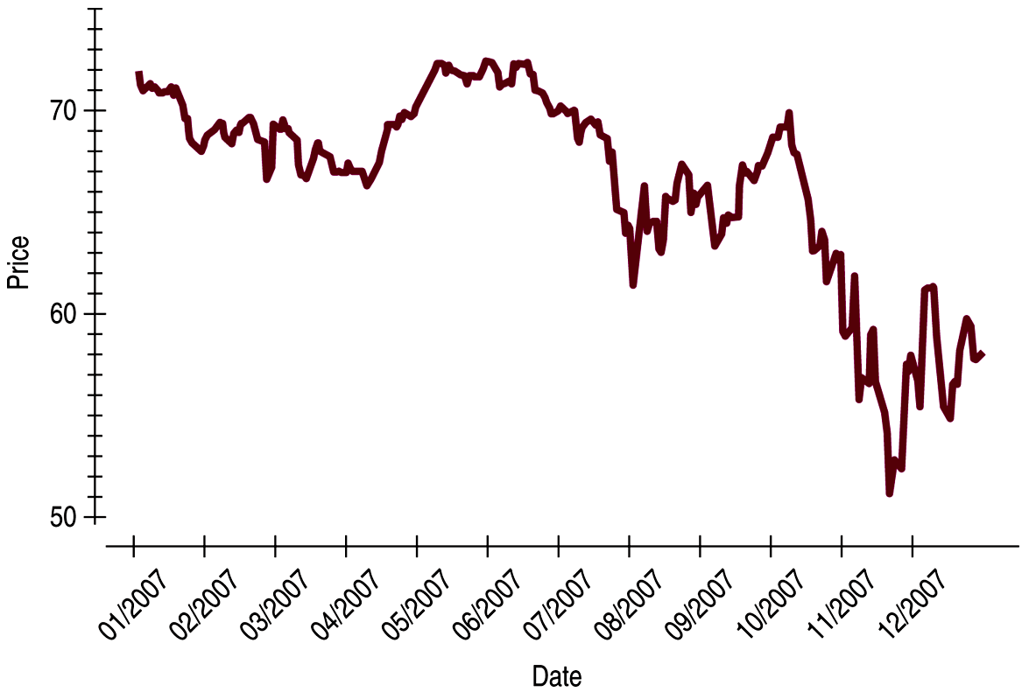
3.10 Time Series Plots
Time series plots often show a great deal of point-to-point variation, but general patterns do emerge from the plot.
Time series plots may be drawn with the points connected. Below the AIG data from before is displayed this way.

Slide 48
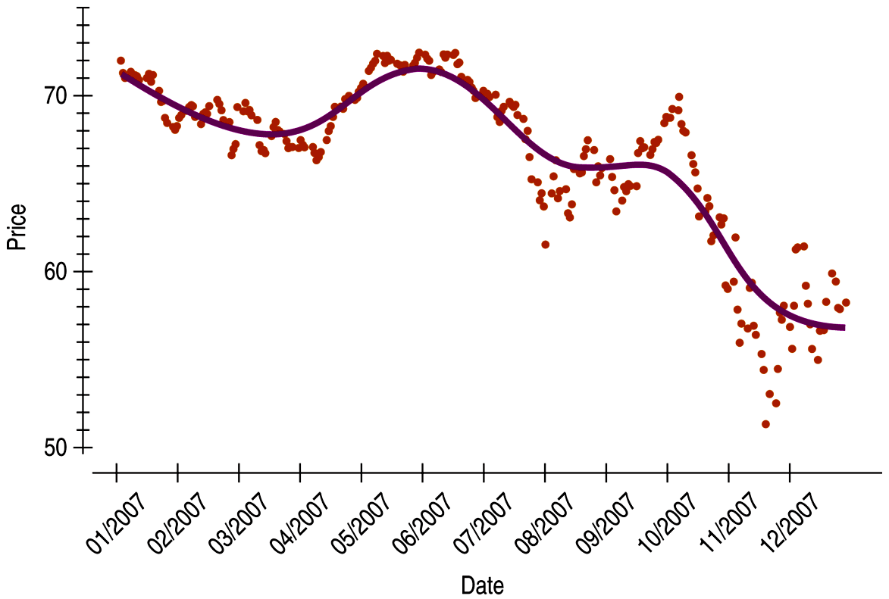
3.10 Time Series Plots
To better understanding the trend of times series data, plot a smooth trace. A trace is typically created using a statistics software package and will be discussed in a later section.
The AIG data has been plotted with a smooth trace below.
Unless there is strong evidence for doing otherwise, we should resist the temptation to think that any trend we see will continue indefinitely.

Slide 49
3.10 Time Series Plots
To better understanding the trend of times series data, plot a smooth trace. A trace is typically created using a statistics software package and will be discussed in a later section.
The AIG data has been plotted with a smooth trace below.
Unless there is strong evidence for doing otherwise, we should resist the temptation to think that any trend we see will continue indefinitely.

Slide 50
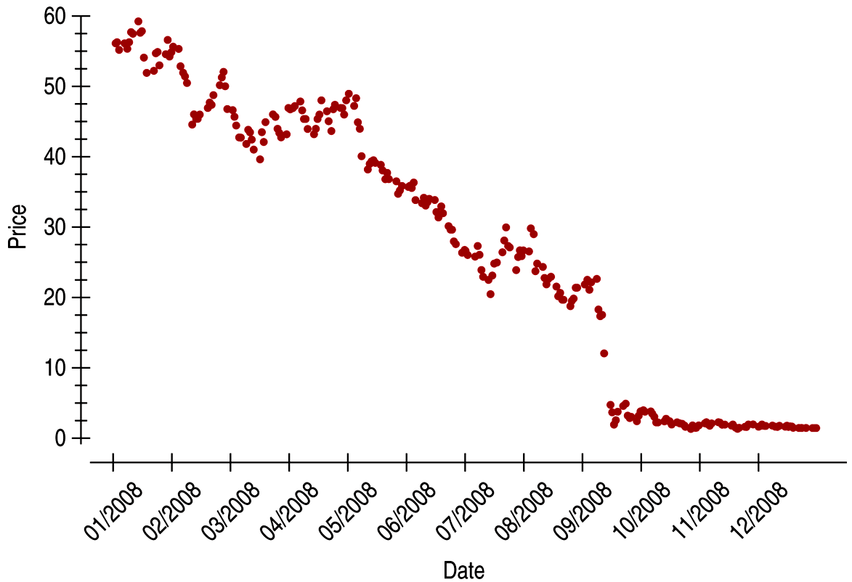
3.10 Time Series Plots
Consider the time series plot for the AIG monthly stock closing price in 2008. The histogram showed a symmetric, possibly unimodal distribution.
The time series plot shows a period of gently falling prices and then the severe decline in September, followed by very low prices.

Slide 51
3.10 Time Series Plots
When a time series is stationary (without a strong trend or change in variability), then a histogram can provide a useful summary.
However, when the time series is not stationary like the AIG prices after 2007, a histogram is unlikely to display much of interest; a time series plot would be more informative.

Slide 52
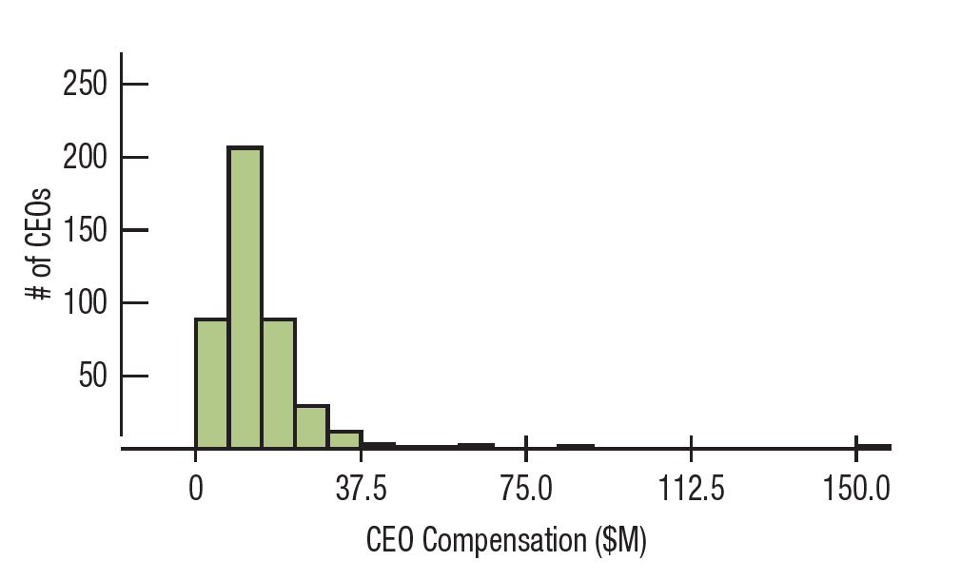
3.11 Transforming Skewed Data
Example: Below we display the very-skewed distribution of total compensation for the CEOs of the 500 largest companies.
What is the “center” of this distribution? Are there outliers?

Slide 53
3.11 Transforming Skewed Data
When a distribution is skewed, it can be hard to summarize the data simply with a center and spread, and hard to decide whether the most extreme values are outliers or just part of the stretched-out tail.
One way to make a skewed distribution more symmetric is to re-express, or transform, the data by applying a simple function to all the data values.
If the distribution is skewed to the right, we often transform using logarithms or square roots; if it is skewed to the left, we may square the data values.

Slide 54
3.11 Transforming Skewed Data
When a distribution is skewed, it can be hard to summarize the data simply with a center and spread, and hard to decide whether the most extreme values are outliers or just part of the stretched-out tail.
One way to make a skewed distribution more symmetric is to re-express, or transform, the data by applying a simple function to all the data values.
If the distribution is skewed to the right, we often transform using logarithms or square roots; if it is skewed to the left, we may square the data values.

Slide 55
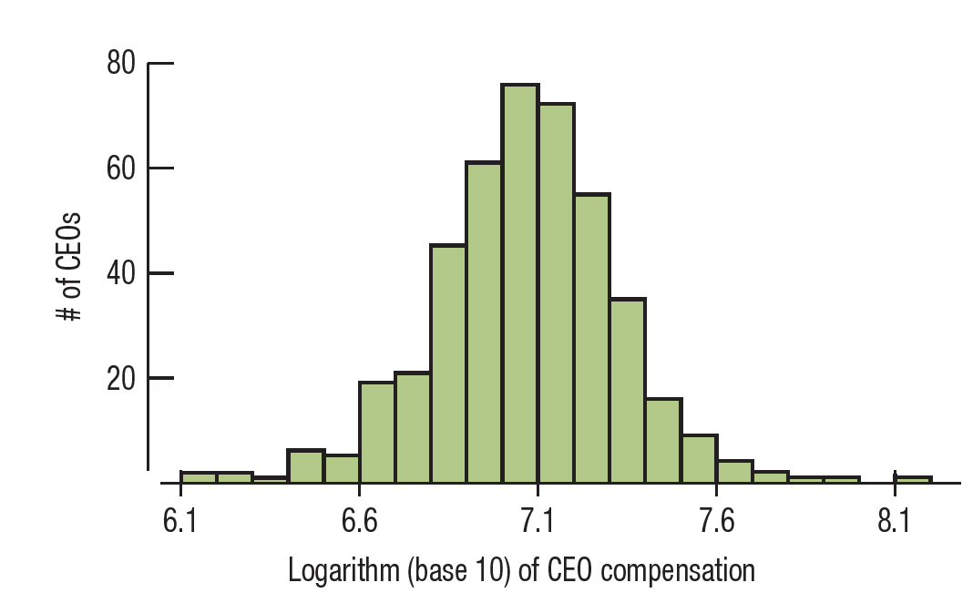
3.11 Transforming Skewed Data
Example: Below we display the transformed distribution of total compensation for the CEOs of the 500 largest companies.
This histogram is much more symmetric, and we see that a typical log compensation is between 6.0 and 8.0 or $1 million and $100 million in the original terms.

Slide 56
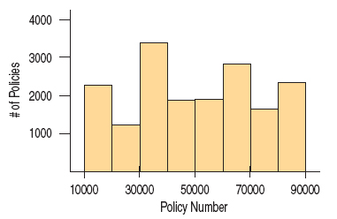
WHAT CAN GO WRONG?
Don’t make a histogram of a categorical variable. The histogram below of policy numbers is not at all informative.

Slide 57
WHAT CAN GO WRONG?
Choose a scale appropriate to the data.
Avoid inconsistent scales. Don’t change scales in the middle of a plot, and compare groups on the same scale.
Label variables and axes clearly.
Do a reality check. Make sure the calculated summaries make sense.
Don’t compute numerical summaries of a categorical variable.

Slide 58
WHAT CAN GO WRONG?
Choose a scale appropriate to the data.
Avoid inconsistent scales. Don’t change scales in the middle of a plot, and compare groups on the same scale.
Label variables and axes clearly.
Do a reality check. Make sure the calculated summaries make sense.
Don’t compute numerical summaries of a categorical variable.

Slide 59
WHAT CAN GO WRONG?
Watch out for multiple modes. If the data has multiple modes, consider separating the data.
Beware of outliers.

Slide 60
FROM LEARNING TO EARNING
Make and interpret histograms to display the distribution of a variable.
We understand distributions in terms of their shape, center, and spread.

Slide 61
FROM LEARNING TO EARNING
Describe the shape of a distribution.
A symmetric distribution has roughly the same shape ref lected around the center.
A skewed distribution extends farther on one side than on the other.
A unimodal distribution has a single major hump or mode; a bimodal distribution has two; multimodal distributions have more.
Outliers are values that lie far from the rest of the data.

Slide 62
FROM LEARNING TO EARNING
Compute the mean and median of a distribution, and know when it is best to use each to summarize
the center.
The mean is the sum of the values divided by the count. It is a suitable summary for unimodal, symmetric distributions.
The median is the middle value; half the values are above and half are below the median. It is a better summary when the distribution is skewed or has outliers.

Slide 63
FROM LEARNING TO EARNING
Compute the standard deviation and interquartile range (IQR), and know when it is best to use each to summarize the spread.
The standard deviation is the square root of the average squared difference between each data value and the mean. It is the summary of choice for the spread of unimodal, symmetric variables.
The IQR is the difference between the quartiles. It is often a better summary of spread for skewed distributions or data with outliers.

Slide 64
FROM LEARNING TO EARNING
Standardize values and use them for comparisons of otherwise disparate variables.
We standardize by finding z-scores. To convert a data value to its z-score, subtract the mean and divide by the standard deviation.
z-scores have no units, so they can be compared to z-scores of other variables.
The idea of measuring the distance of a value from the mean in terms of standard deviations is a basic concept in statistics and will return many times later in the course.

Slide 65
FROM LEARNING TO EARNING
Find a five-number summary and, using it, make a boxplot. Use the boxplot’s outlier nomination rule to identify cases that may deserve special attention.
A five-number summary consists of the median, the quartiles, and the extremes of the data.
A boxplot shows the quartiles as the upper and lower ends of a central box, the median as a line across the box, and “whiskers” that extend to the most extreme values that are not nominated as outliers.
Boxplots display separately any case that is more than 1.5 IQRs beyond each quartile. These cases should be considered as possible outliers.

Slide 66
FROM LEARNING TO EARNING
Use boxplots to compare distributions.
Boxplots facilitate comparisons of several groups. It is easy to compare centers (medians) and spreads (IQRs).
Because boxplots show possible outliers separately, any outliers don’t affect comparisons.
Make and interpret time plots for time series data.
• Look for the trend and any changes in the spread of the data over time.

